Slide 1
Week 7-Teamwork
第7周 - 团队合作

Slide 2
Teams in organisations
组织中的团队
Team
  A small group of people with complementary skills, who interact and work together to achieve shared goals.
Teamwork
  The process of people working together to achieve these goals.
团队
一小群具有互补技能的人，他们互动并共同努力实现共同目标。
团队合作
人们共同努力实现这些目标的过程。

Slide 3
The five elements that make teams function
使团队发挥作用的五个要素
Common commitment and purpose
Specific performance goals
Complementary skills
Commitment to how the work gets done
Mutual accountability
共同的承诺和目标
具体绩效目标
互补技能
对如何完成工作的承诺
相互问责

Slide 4
Benefits of teamwork
团队合作的好处
Performance gains through synergy
More resources for problem solving
Improved creativity and innovation
Improved quality of decision making
Greater member commitment to tasks
Increased motivation of members
Increased need satisfaction of members
通过协同作用提高性能
用于解决问题的更多资源
提高创造力和创新能力
提高决策质量
成员对任务的更大承诺
提高会员的积极性
提高会员的需求满意度

Slide 5
Disadvantages of teamwork
团队合作的缺点
Personality conflicts and work style differences
Time consuming
Lack of motivation
Social loafing
  Ways to overcome social loafing
      making individual contributions more visible,
      rewarding individuals for their contributions,
      making task assignments more interesting,
      and keeping group size.
性格冲突和工作风格差异
耗时
缺乏动力
社交懒惰
克服社交懒惰的方法
使个人贡献更加引人注目，
奖励个人的贡献，
使任务分配更有趣，
以及保持小组规模。

Slide 6
Functions of an effective team高效团队的职能
Perform its tasks
    Resources and Setting
    Nature of the Task
    Team Size
Satisfy its members
Remain viable for the future
执行其任务
资源和设置
任务的性质
团队规模
让会员满意
为未来保持活力

Slide 7
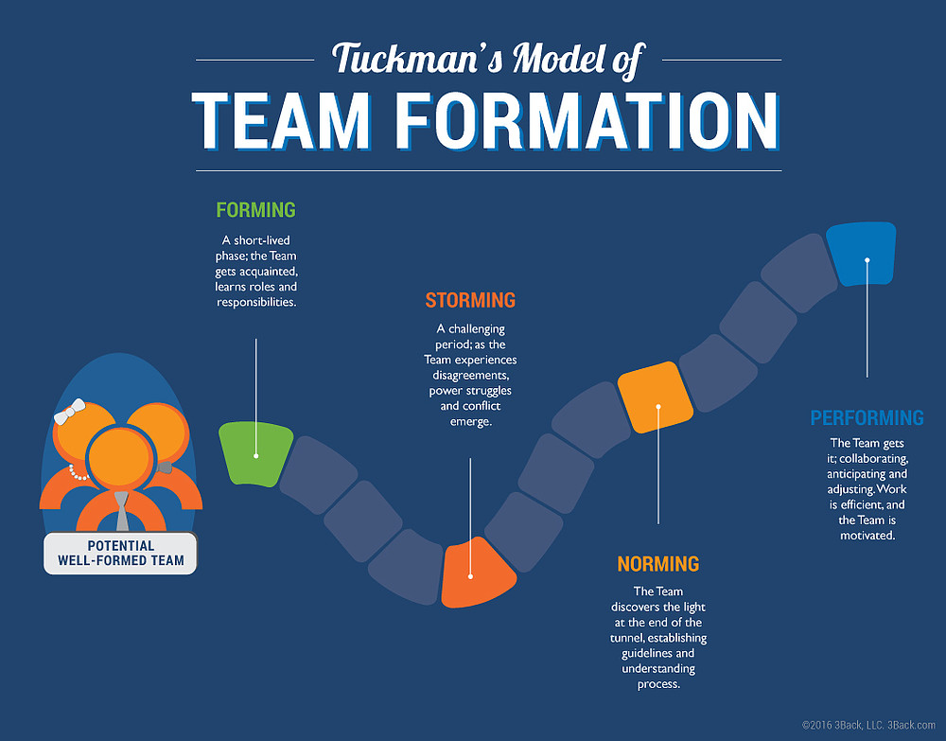
塔克曼团队形成模型
组建期（Forming） 这是一个短暂的阶段，团队成员彼此熟悉，了解各自的角色和职责。
激荡期（Storming） 这是一段充满挑战的时期，团队会出现意见分歧、权力争夺和冲突。
执行期（Performing） 团队运转良好，成员相互协作，能提前预判并灵活调整。工作高效，团队充满动力。
潜在的优秀团队
规范期（Norming） 团队迎来曙光，建立起指导方针，成员们理解并遵循相应流程。

Slide 8
Norms 规范
团队成员应遵循的行为、规则或标准。
Norms 规范
  Behaviours, rules or standards expected to be followed by team members.
Guidelines to build positive norms:
  Act as a positive role model
  Reinforce the desired behaviours
  Control results by performance reviews and regular feedback.
  Hold regular meetings to discuss progress and ways of improving.
  Use team decision-making methods
  Train and orient new members; recruit new members with desired behaviours
建立积极规范的指导方针：
树立积极的榜样
强化期望的行为
通过绩效评估和定期反馈来控制结果。
定期召开会议，讨论进展和改进方法。
使用团队决策方法
培训和定位新成员;招募具有理想行为的新成员

Slide 9
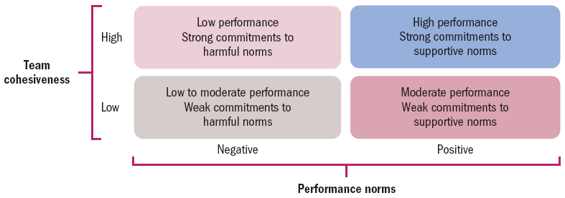
Cohesiveness 凝聚力
Cohesiveness- The degree to which members are attracted to and motivated to remain part of a team.
凝聚力 - 成员被团队吸引并有动力保持团队一部分的程度。
Notes:
Norms vary in the degree to which they are accepted and adhered to by team members.
Conformity to norms is largely determined by the strength of cohesiveness, defined as the degree to which members are attracted to and motivated to remain part of a team. People in a highly cohesive team value their membership and strive to maintain positive relationships with other team members. They experience satisfaction from team identification and interpersonal relationships. Because of this, highly cohesive teams are good for their members.
They can also be very good for organisations, but not always. It all depends on the performance norm that the cohesiveness is paired with.
A basic rule of group dynamics is: The more cohesive the team, the greater the conformity of members to team norms. This has important implications for team performance. When the performance norm of a team is positive, high cohesion and the resulting conformity to norms has a beneficial effect on overall team performance.

Slide 10
Cohesiveness
Guidelines to increase cohesion:
  Create agreement on team goals.
  Reward team rather than individual results.
  Increase interactions among members.
  Decrease team size.
  Introduce competition with other teams.
增加凝聚力的准则：
就团队目标达成协议。
奖励团队而不是个人结果。
增加成员之间的互动。
减少团队规模。
引入与其他团队的竞争。

Slide 11
Conformity 整合
Groupthink occurs when a group exerts extensive pressure on an individual to align his or her opinion with others’ opinions. It’s a tendency for highly cohesive teams to lose their evaluative capabilities.
当一个群体对个人施加巨大压力以使其观点与他人的观点保持一致时，就会发生群体思维。高度凝聚力的团队往往会失去他们的评估能力。

Slide 12
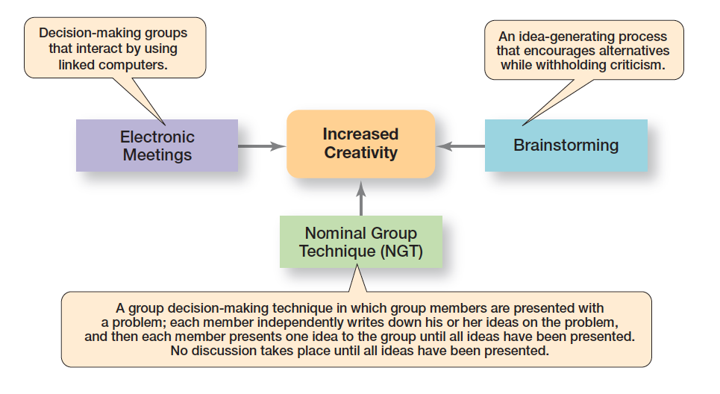
Exhibit 13-6 Creative Group Decision Making创意团队决策
电子会议（Electronic Meetings）：决策小组通过联网计算机进行互动。
头脑风暴（Brainstorming）：一种鼓励提出不同想法且不进行批评的创意生成过程。
名义群体法（Nominal Group Technique, NGT）：一种群体决策技术，向小组成员提出一个问题，每个成员独立写下自己对该问题的想法，然后依次向小组陈述一个想法， 直到所有想法都陈述完毕，才开始进行讨论。
以上三者共同作用以提升创造力（Increased Creativity）。
Exhibit 13-6 represents three techniques managers can use to help groups make more creative decisions. 图 13-6 代表了管理者可以用来帮助团队做出更具创造性决策的三种技术。
Notes:
What techniques can managers use to help groups make more creative decisions? Exhibit 13-6 describes three possibilities.

Slide 13
Conflict Management 冲突管理
Conflict: perceived incompatible differences that result in interference or opposition
  Traditional view of conflict: the view that all conflict is bad and must be avoided
  Human relations view of conflict: the view that conflict is a natural and unavoidable outcome in any group
  Interactionist view of conflict: the view that some conflict is necessary for a group to perform effectively.
冲突：感知到的不相容差异，导致干扰或对立
传统的冲突观：认为所有冲突都是坏的，必须避免
人际关系冲突观：认为冲突是任何群体的自然和不可避免的结果
互动主义冲突观 ：认为某些冲突对于团队有效执行是必要的。
Notes:
Conflict is perceived incompatible differences resulting in some form of interference or opposition. Whether the differences are real is irrelevant. If people in a group perceive that differences exist, then there is conflict.
The traditional view of conflict argues that conflict must be avoided—that it indicates a problem within the group. Another view, the human relations view of conflict, argues that conflict is a natural and inevitable outcome in any group and need not be negative but has the potential to be a positive force in contributing to a group’s performance.

Slide 14
Interactionist View of Conflict
互动主义冲突观
Interactionist view of conflict: the view that some conflict is necessary for a group to perform effectively
  Functional conflicts: conflicts that support a group’s goals and improve its performance
  Dysfunctional conflicts: conflicts that prevent a group from achieving its goals
互动主义冲突观：认为某些冲突对于团队有效执行是必要的
功能冲突：支持组目标并提高其绩效的冲突
功能失调的冲突：阻碍团队实现其目标的冲突
Notes:
The third and most recent view, the interactionist view of conflict, proposes that not only can conflict be a positive force in a group but that some conflict is absolutely necessary for a group to perform effectively.
The interactionist view doesn’t suggest that all conflicts are good. Some conflicts—functional conflicts—are constructive and support the goals of the work group and improve its performance. Other conflicts—dysfunctional conflicts—are destructive and prevent a group from achieving its goals.

Slide 15
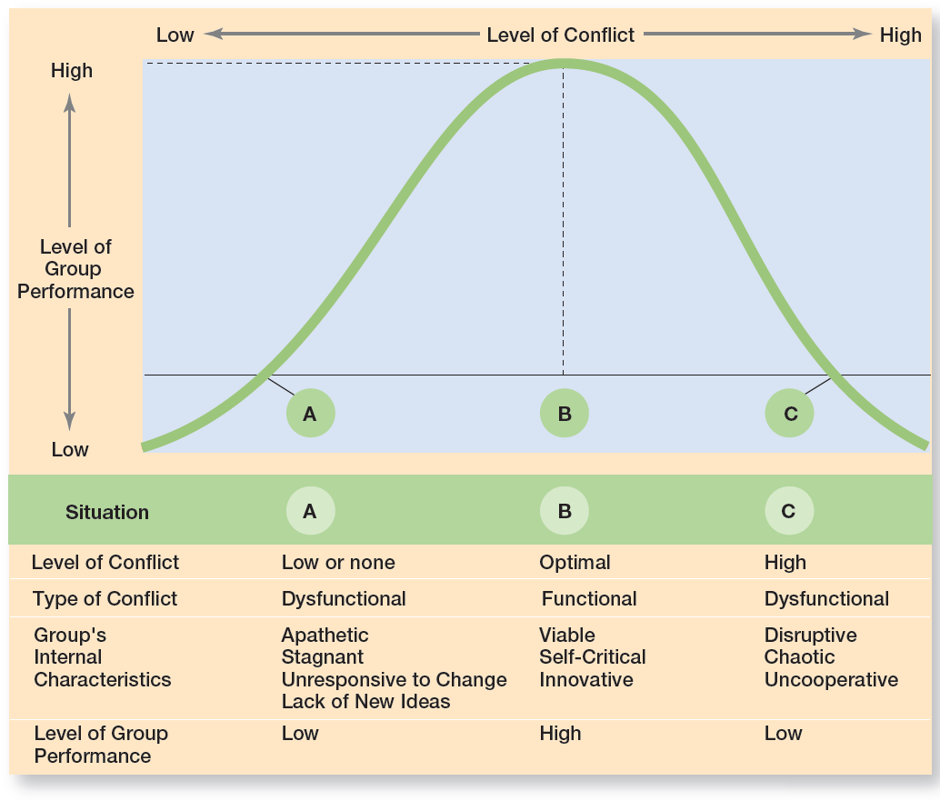
Exhibit 13-7 Conflict and Group Performance 冲突和组绩效

Slide 16
情况 | A | B | C
冲突水平 | 低或无 | 最佳 | 高
冲突类型 | 破坏性冲突（Dysfunctional） | 建设性冲突（Functional） | 破坏性冲突（Dysfunctional）
团队内部特征 | 冷漠、停滞、对变化无反应、缺乏新想法 | 可行、自我批判、创新 | 混乱、不合作
团队绩效水平 | 低 | 高 | 低

Slide 17
Types of Conflict 冲突类型
Task conflict: conflict over content and goals of the work
Relationship conflict: conflict based on interpersonal relationships
Process conflict: conflict over how work gets done
任务冲突：工作内容和目标的冲突
关系冲突：基于人际关系的冲突
流程冲突：关于工作完成方式的冲突
Notes:
Task conflict relates to the content and goals of the work. Relationship conflict focuses on interpersonal relationships.
Process conflict refers to how the work gets done. Research shows that relationship conflicts are almost always dysfunctional because the interpersonal hostilities increase personality clashes and decrease mutual understanding and the tasks don’t get done. On the other hand, low levels of process conflict and low-to-moderate levels of task conflict are functional. For process conflict to be productive, it must be minimal.
Otherwise, intense arguments over who should do what may become dysfunctional and can lead to uncertainty about task assignments, increase the time to complete tasks, and result in members working at cross-purposes.

Slide 18
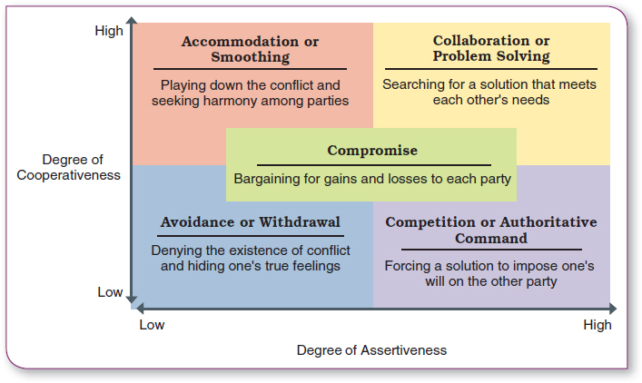
Conflict Management
冲突管理

Slide 19
横坐标：武断程度（Degree of Assertiveness），从低（Low）到高（High）
纵坐标：合作程度（Degree of Cooperativeness），从低（Low）到高（High）
四个象限及对应策略
左上象限：迁就或缓和（Smoothing） 淡化冲突，寻求各方之间的和谐。
右上象限：协作或解决问题（Problem Solving） 寻找能满足彼此需求的解决方案。
左下象限：回避或退缩（Avoidance） 否认冲突的存在，隐藏自己的真实感受。
右下象限：竞争或命令（Competition） 强行推行一种解决方案，将自己的意愿强加给对方。
中间区域：妥协（Compromise） 各方进行得失权衡的谈判 。

Slide 20
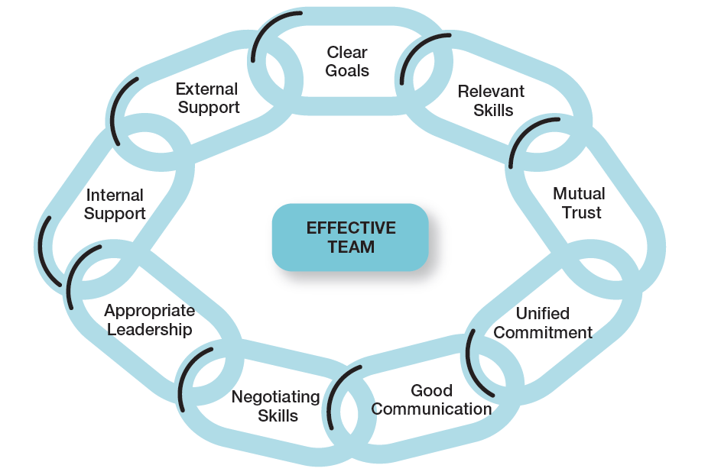
Exhibit 13-9 Characteristics of Effective Teams
图表 13-9 有效团队的特征
高效团队（EFFECTIVE TEAM）的构成要素
清晰的目标（Clear Goals）
- 相关的技能（Relevant Skills）
相互的信任（Mutual Trust）
- 一致的承诺（Unified Commitment）
良好的沟通（Good Communication）
谈判技能（Negotiating Skills）
恰当的领导力（Appropriate Leadership）
内部支持（Internal Support）
- 外部支持（External Support）
Notes:
Research on teams provides insights into the characteristics typically associated with effective teams. These characteristics are listed in Exhibit 13-9.

